Slide 1

Data Storytelling - YouTube Trending Videos Analysis
What Makes Videos Trend on YouTube?
In today’s content-driven era, the battle for attention on platforms like YouTube is fierce. To uncover what really captures the audience’s interest, I analyzed a dataset of trending YouTube videos across regions, focusing on genres and the emotions behind video titles.

Slide 2

Objective
Uncover patterns in trending YouTube videos across regions by analyzing:
• Most popular video genres
• Emotional tone of video titles (sentiment)

Slide 3
Dataset and Tools used
Dataset: Trending videos from YouTube
Tools: Python (Pandas, TextBlob), Tableau
Metrics Analyzed: View count, video category, title sentiment

Slide 4
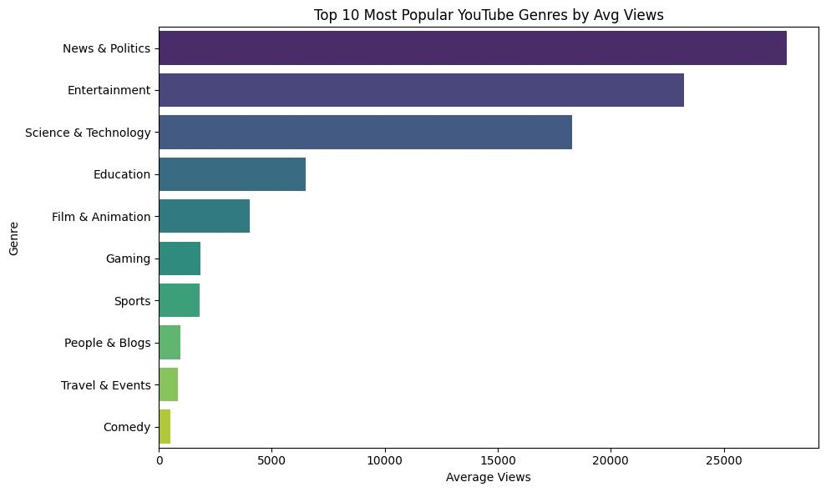
Top 10 Most Popular Genres (by Average Views)
News & Politics (~28,000 avg views)
Entertainment (~23,000 avg views)
Science & Technology (~18,000 avg views)
🎯 Insight: “News & Politics” and “Entertainment” dominate in terms of average views.

Slide 5
Genre Popularity: Viewers Tune In for Information and Entertainment
On analysis of average views across video categories revealed a clear preference :
News & Politics emerged as the most viewed genre, with an average of nearly 28,000 views per video. This suggests audiences are turning to YouTube as a real-time source of information.
Entertainment followed closely, proving the timeless appeal of fun and escapism in video content .
Surprisingly, Science & Technology ranked third, outperforming categories like Gaming and Comedy, which traditionally dominate youth engagement.
📌 Takeaway: People crave both timely updates and smart entertainment. Channels that blend the two—like infotainment—may have a strategic edge.

Slide 6
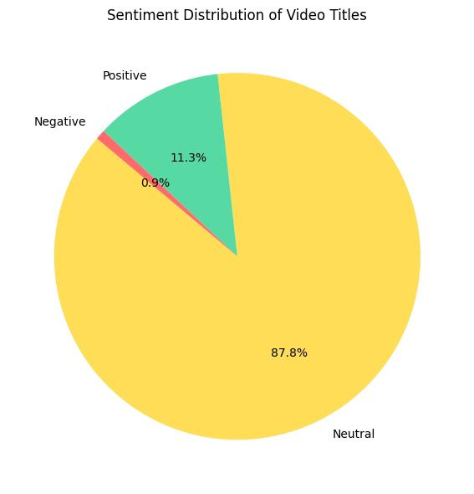
Sentiment Distribution of Video Titles
Sentiment Count
Neutral – 101
Positive – 13
Negative – 1
🎯 Insight: Most trending video titles are neutral in sentiment; only a few evoke strong positive or negative tones.

Slide 7
Sentiment Signals: Neutral Titles Dominate Trends
After running a sentimental analysis on video titles to understand the emotional tone creators use, here’s what I found :
Over 85% of titles were neutral in sentiment — neither overtly emotional nor controversial.13% were positive, often using words like “best”, “celebration”, or “success”.
Only 1 video had a negative sentiment title, indicating creators avoid negativity when aiming for virality.
📌 Takeaway: Trending videos typically rely on neutral or uplifting titles, avoiding negativity. Creators may be optimizing for algorithms that reward positivity—or steering clear of polarizing language to attract broader audiences.

Slide 8
What Works on YouTube?
From this data, a clear story emerges:
Information-rich content (like news and science) performs surprisingly well.
Emotionally neutral or positive messaging in titles increases the chance of widespread appeal.
Emerging genres like Educational content are growing but still under-viewed compared to mainstream categories.

Slide 9
For Creators and Marketers:
If you're planning your next viral video:
Choose titles that spark curiosity without controversy.
Align your content with high-performing genres like entertainment, news, or tech.
Track sentiment in your content over time—it might just be your secret to better engagement.

